Slide 2
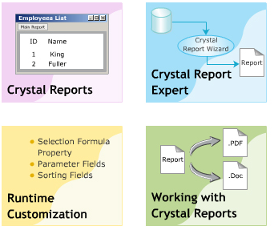
Crystal Report Objective
Crystal Reports
Crystal Report Expert
Runtime Customization
Working with Crystal Reports

Slide 3
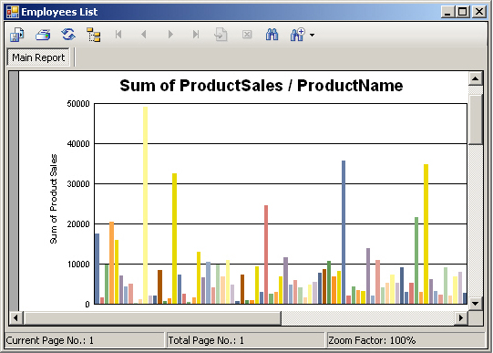
Introduction to Crystal Reports
Allows user to generate reports by summarizing data and presenting it in a graphical format.
Advantages:
Simplifies the process of analyzing data by generation of graphs.
Accelerates the process of computing complex calculation.
Displays data easily based on the search criteria or using various charts and graphs.
Format Data easily.

Slide 4
Features of Crystal Report
Data access:
Easily access DB, files … with more than 35 data drivers
Flexibility in connection to DB by creating SQL commands.
Runtime Customization
Interaction between Report Viewer and Other controls:
Report Engine Model provides interactivity between report viewer control and other controls in Windows Form page:
Report viewer control allows to display reports on the form.
Reports as Web Services:
Web service is invoked by client through HTTP and XML, allows transfer data between the Web Service & client.
Reusability
Security
Notes:
Flexibility : the ability to change or be changed easily according to the situation

Slide 5
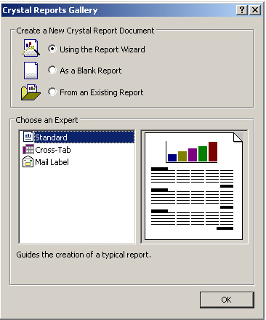
Crystal Report Creation Wizard
Guide to choose a data source and link to the tables
Also guides to sum up the totals, sort data, create charts and select records.
There are 3 types:
Standard
Cross-Tab
Mail Label
Mailing Labels Report Creation Wizard guides to create a report that prints on a mailing label

Slide 6

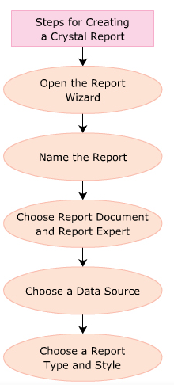
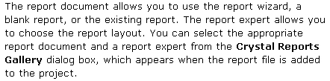


Step to create

Slide 7
Create Crystal Report using ADO.Net
CrystalReportViewer cvrEmployee = new CrystalReportViewer();
SqlDataAdapter sqlda = new SqlDataAdapter(“Select * from Employees” , con);
ReportDocument rdReport = new ReportDocument();
rdReport.Load(“D:/Employee.rpt”);
DataSet ds = new DataSet();
sqlda.Fill(ds , “Employees”);
rdReport.SetDataSource(ds);
cvrEmployee.ReportSource = rdReport;

Slide 8
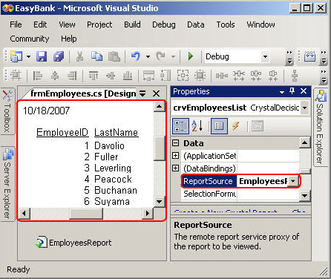
Binding Report Passing Params
Binding a report to the application by using CrystalReportViewer control.
Passing a parameter on a database field allows the user to specify values for that field to filter the records.

Slide 9
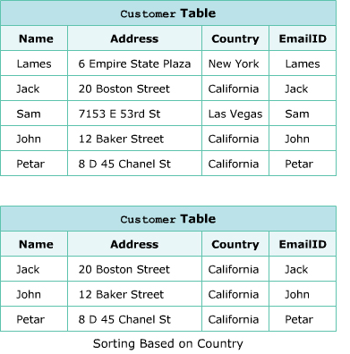
Sorting field at runtime
CrystalReportViewer cvrEmployee = new CrystalReportViewer();
SqlDataAdapter sqlda = new SqlDataAdapter(“Select * from Employees” , con);
ReportDocument rdReport = new ReportDocument();
rdReport.Load(“D:/Employee.rpt”);
DataSet ds = new DataSet();
sqlda.Fill(ds , “Employees”);
rdReport.SetDataSource(ds);
cvrEmployee.ReportSource = rdReport;
FieldDefinition fdCountry = rdReport.Database.Tables[0].Fields[“Country”];
rdReport.DataDefinition.SortFields[0].Field = fdCountry;
rdReport.DataDefinition.SortFields[0].SortDirection = CrystalDecisions.Shared.SortDirection.DescendingOrder;
Notes:
when u received this kind of error:
"Could not load file or assembly 'file:///C:\Program Files\SAP BusinessObjects\Crystal Reports for .NET Framework 4.0\Common\SAP BusinessObjects Enterprise XI 4.0\win32_x86\dotnet1\crdb_adoplus.dll' or one of its dependencies. The system cannot find the file specified."try to add this to your .config file (usually app.config) Fix error:
< startup useLegacyV2RuntimeActivationPolicy="true">
< supportedRuntime version="v4.0" sku=".NETFramework,Version=v4.0"/>
< /startup>

Slide 10
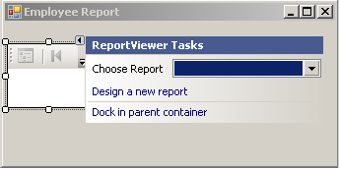
CrystalReportViewer control
CrystalReportViewer supports data binding & displays the designed report on the form:
Display report page wise
Can move between pages displayed in the control.
To use the control, it should be dragged on to the Windows Form. Then, the ReportSource property must be used to assign the source for the report.
Some features of this control are :
Smart tasks
Tooltip disable option
Error event
Multilingual client support
Report selection from Properties Window
Design Time Preview
Notes:
Drag : to move something by pulling it along a surface, usually the ground

Slide 11
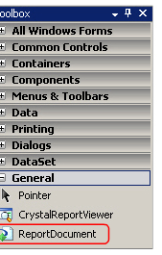
ReportDocument object model
Is a powerful and flexible model to handle the report at runtime.
Provides many built-in class in different namespaces that are use to create, update and save report at runtime.
One of the most important class in this model is the ReportDocument class belonged in the namespace CrystalDecisions.CrystalReport.Engine

Slide 12
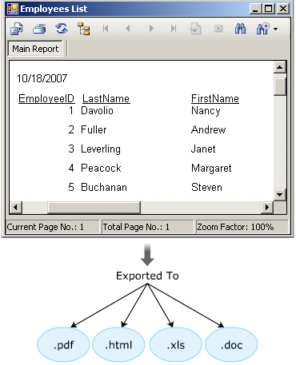
Purpose and Format
Adobe Acrobat (.pdf)
Crystal Reports for VS .NET (.rpt)
HTML 3.2 and 4.0 (.html)
Microsoft Excel (.xls)
Microsoft Rich Text (.rtf)
Microsoft (.doc)

Slide 13
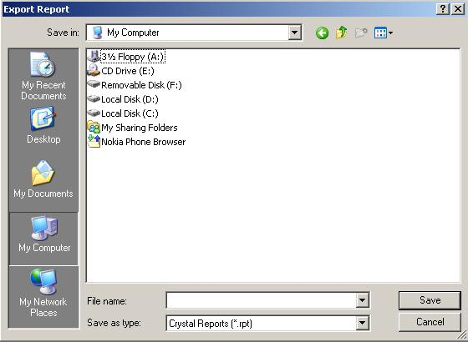
Exporting a Report
Use the Export button on the toolbar of CrystalReportViewer Control
Use the ExportReport() method of CrystalReportViewer class. This method invokes the Export Report DialogBox as bellow :

Slide 14
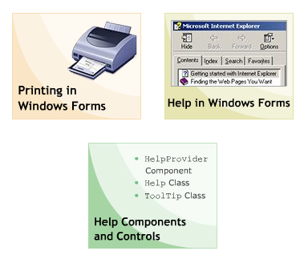
Printing & Help Objective
Printing in Windows Forms
Help in Windows Forms
Help Components and Controls

Slide 15
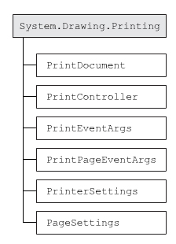
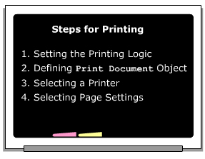
Steps for Printing
Must have PrintDocument object
Invoke the Print() method
This will raise PrintPage event which takes an object PrintPageEventArgs
Pages Setting by PageSetupDialog

Slide 16
PrintDocument
Provides ability to print documents : .txt , .pdf …
Two main purpose :
Single print job
Complex print job
Property | DefaultPageSettings, DocumentName, PrintController, PrinterSettings
Method | OnBeginPrint, OnEndPrint, OnPrintPage, Print, ToString
Event | BeginPrint, EndPrint, PrintPage

Slide 17
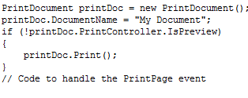
PrintController
Regulates printing process of PrintDocument
Is an abstract class
Derived class : StandardPrintController , PreviewPrintController, PrintControllerWithStatusDialog
Property | IsPreview
Method | OnStartPrint, OnEndPrint, OnStartPage, OnStartPage

Slide 18

PrinterSettings
Specifies how a document is printed, including the printer
You can access this class by PrintDocument.PrinterSettings or PageSettings.PrinterSettings
Property | Copies, DefaultPageSettings, InstalledPrinters, PrinterName, PrinterResolutions, PrintFileName, ToPage

Slide 19


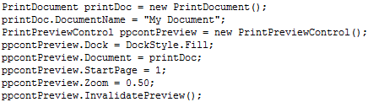
Dialog Boxes Component Controls
PrintDocument
PrintPreviewDialog
PrintDialog
PrintPreviewControl

Slide 20
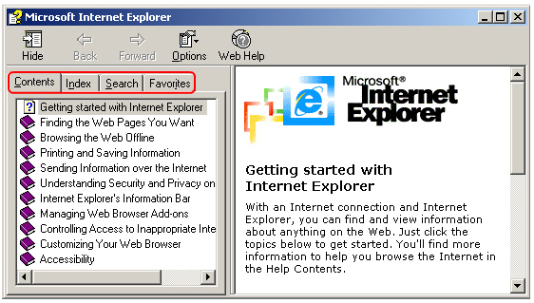

Help in Application
Help class is used to display the content of .chm file
Method | Description
ShowHelp | Displays the help file contents
ShowHelpIndex | Displays the index of a help file
ShowPopup | Displays a Help pop-up window

Slide 21
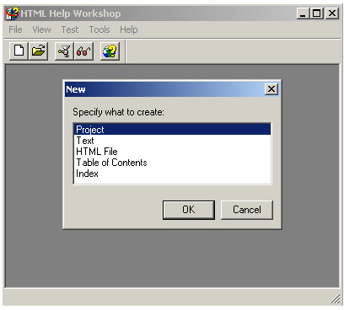
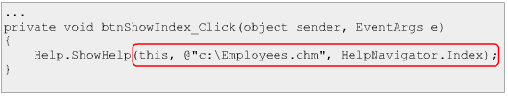
ShowHelp() method - Software
This method takes 3 parameters: control , “.chm” , and element need display.
Options: HelpNavigator.Index, HelpNavigator.TableOfContents
There are many software to create .chm file. But HTML Help WorkShop is provided by Microsoft :
It helps to create .hhp file (help system) - .hhc

Slide 22
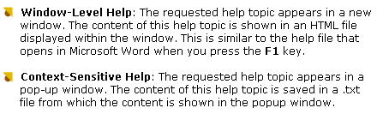
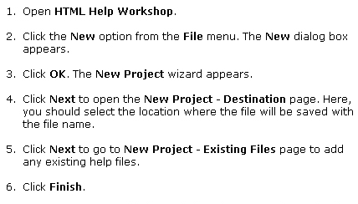
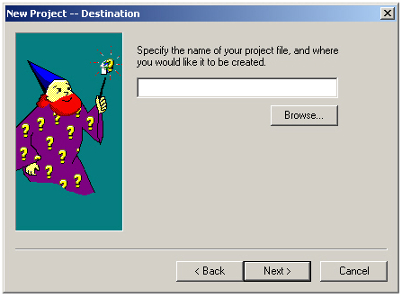
Types of Help & Steps to create .chm

Slide 23
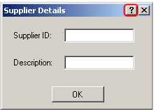

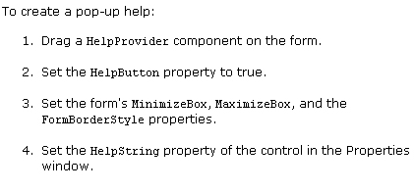
HelpButton property

Slide 24

ToolTip
Property | Active, IsBalloon, ShowAlways, ToolTipIcon, ToolTipTitle
Method | GetToolTip, Hide, RemoveAll, SetToolTip, Show, ToString
Event | Draw, Popup

Slide 25
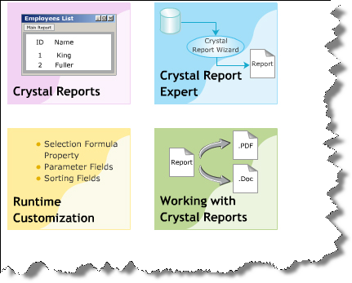
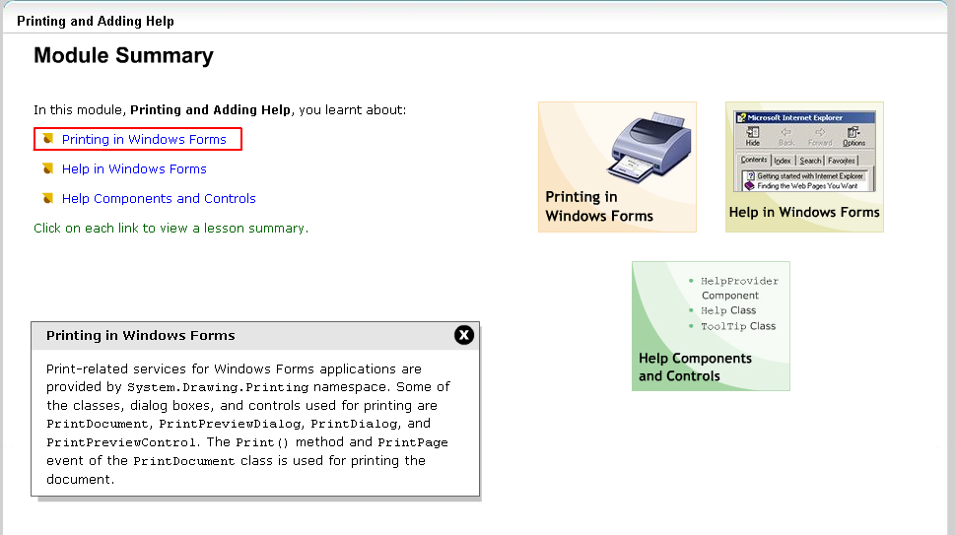
Summary

